Slide 1

Spring of Code
Artificial Intelligence
(Machine Learning & Deep Learning)
Instructor
Asad Ullah
- Research Assistant (DIP Lab)
Duration
03 Months
(Feb – April)

Slide 2
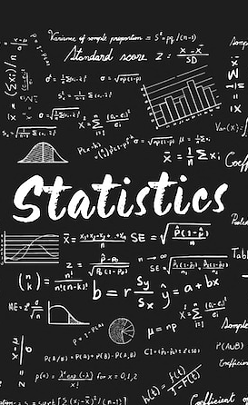
Day 04 – Descriptive Statistics
(Data and Its Types)
Objectives:
What is Descriptive Statistics?
What is Data?
Different Types of Data
Measure of Central Tendency

Slide 3
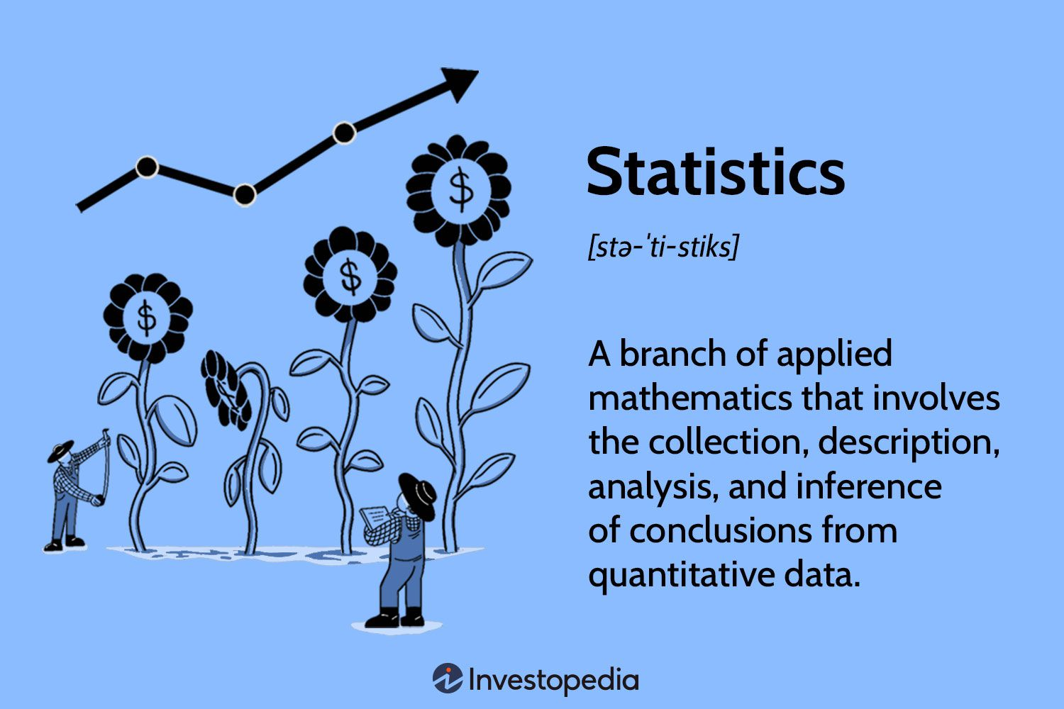
What is Statistics?
Notes:
Real-World Analogy:
Think of statistics as a detective toolkit for understanding the world:
A detective collects evidence (data collection)
Organizes evidence (descriptive statistics)
Finds patterns (analysis)
Solves the case (inference)
Statistics helps us:
Make Decisions - Should we launch this product?
Understand Patterns - Why are sales dropping?
Predict Future - What will next quarter look like?
Test Ideas - Does this medicine work?
Descriptive Statistics
Inferential Statistics

Slide 4
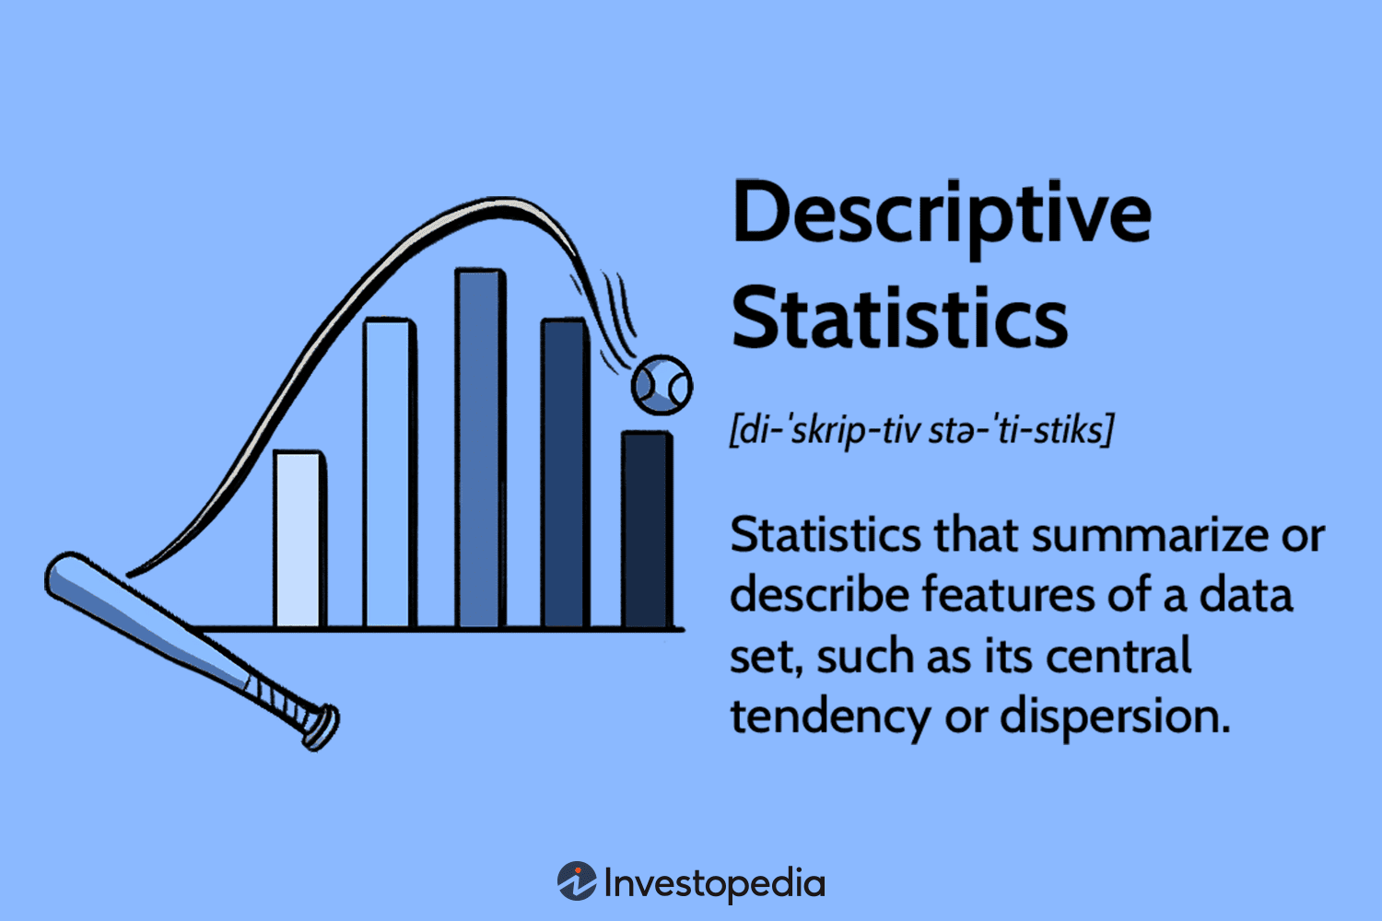
Notes:
What it answers:
What does the data look like?
What's the center/average?
How spread out is the data?
Tools:
Mean, Median, Mode
Graphs and charts
Standard deviation, range

Slide 5
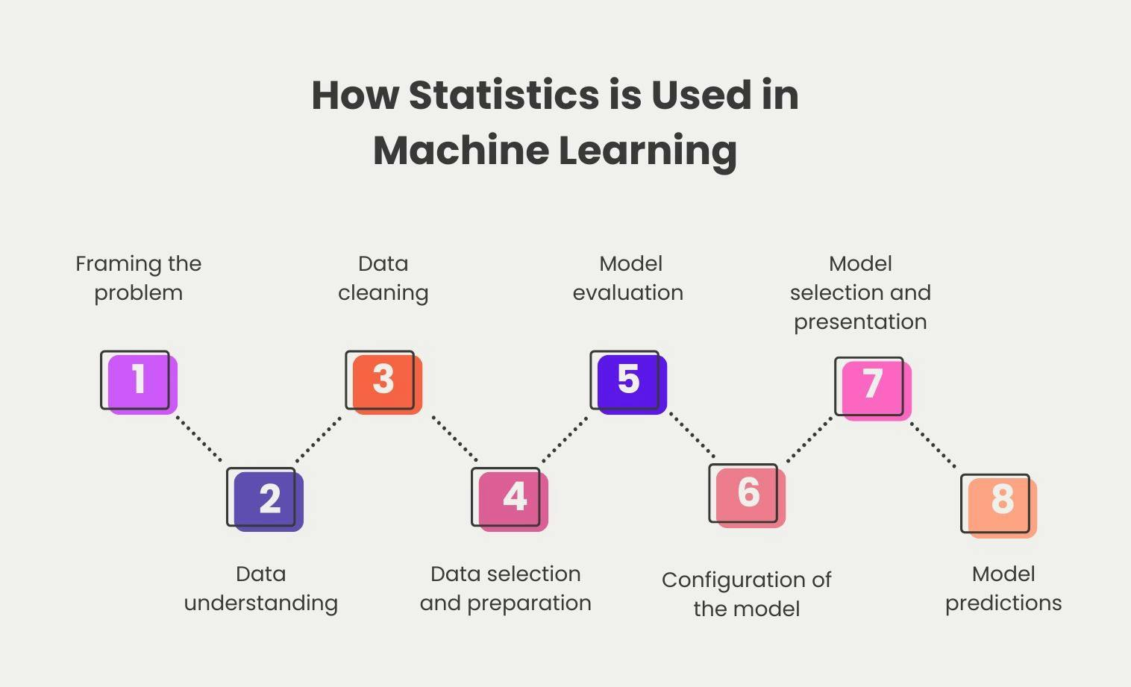

Slide 6
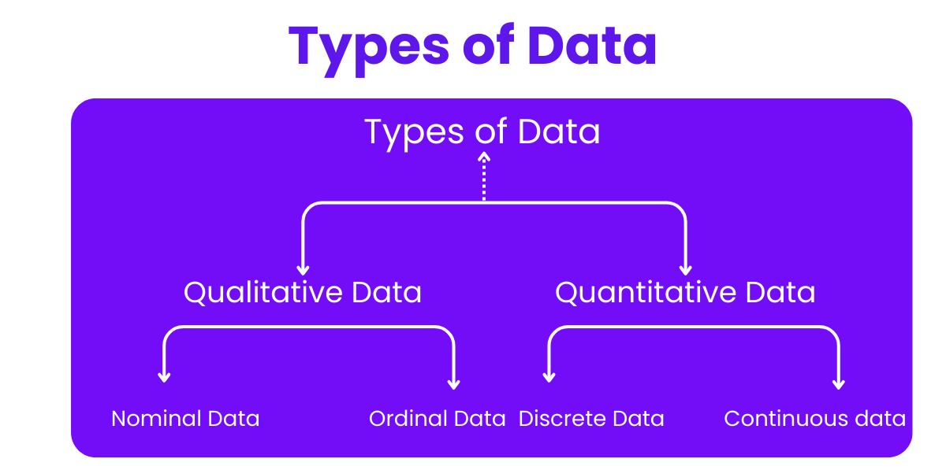
Notes:
DATA TYPES
│
├─── QUALITATIVE (Categorical)
│ ├─── Nominal (No order)
│ │ └─── Examples: Colors, Gender, City names
│ │
│ └─── Ordinal (Natural order)
│ └─── Examples: Ratings, Education level, Rankings
│
└─── QUANTITATIVE (Numerical)
├─── Discrete (Countable)
│ └─── Examples: Number of students, Cars sold
│
└─── Continuous (Measurable)
└─── Examples: Height, Temperature, Time

Slide 7
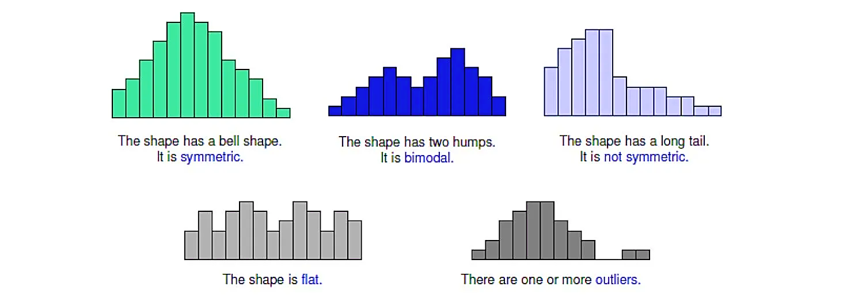
Data Distribution
Data distribution describes how values in a dataset are spread or clustered across a range. It reveals the nature of the data, providing insight into its central tendency, variability, and shape.

Slide 8
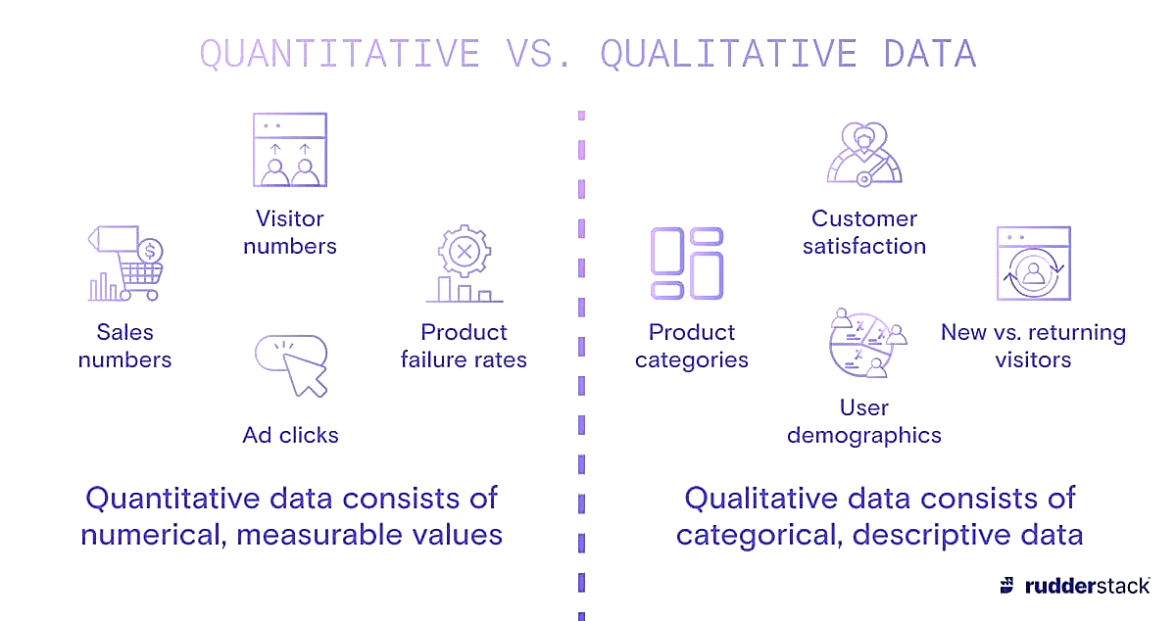
Qualitative Data
Qualitative data refers to non-numerical information that describes characteristics.
Focuses on words, meanings, opinions, feelings, and descriptions.
Gathered through interviews, open-ended surveys, focus groups, observations etc.
Analyzed through categorization, or coding to identify patterns and insights

Slide 9
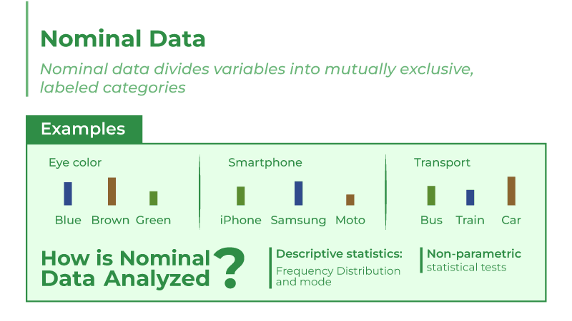
Qualitative Data

Slide 10
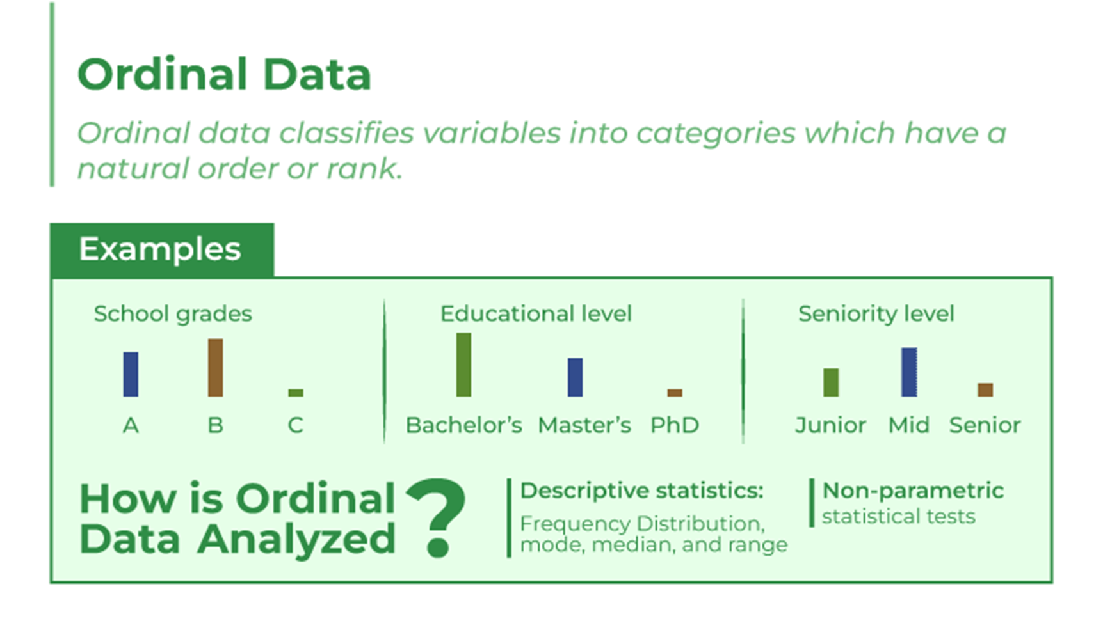
Qualitative Data

Slide 11
Quantitative Data
Quantitative data refers to numerical information that can be measured, counted, and expressed in numbers.
Focuses on quantities, amounts, and measurable values.
Gathered through surveys with close-ended questions, experiments, observations.
analyzed using statistical methods, graphs, and mathematical models to identify patterns and trends

Slide 12
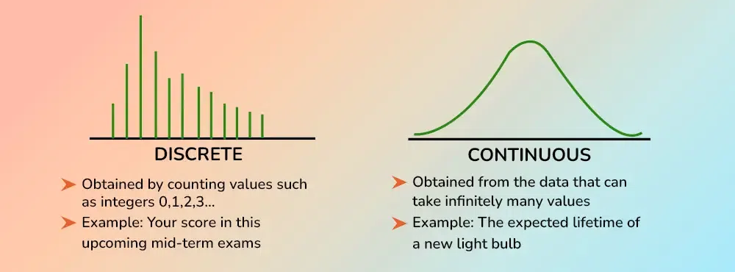
Quantitative Data

Slide 13
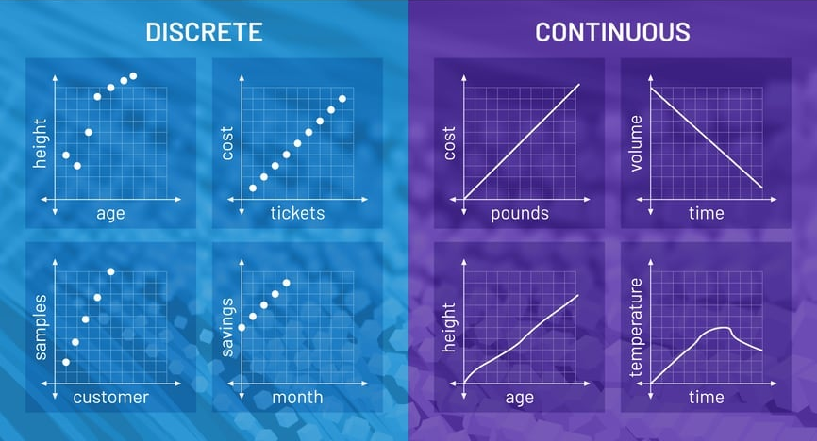
Quantitative Data

Slide 14
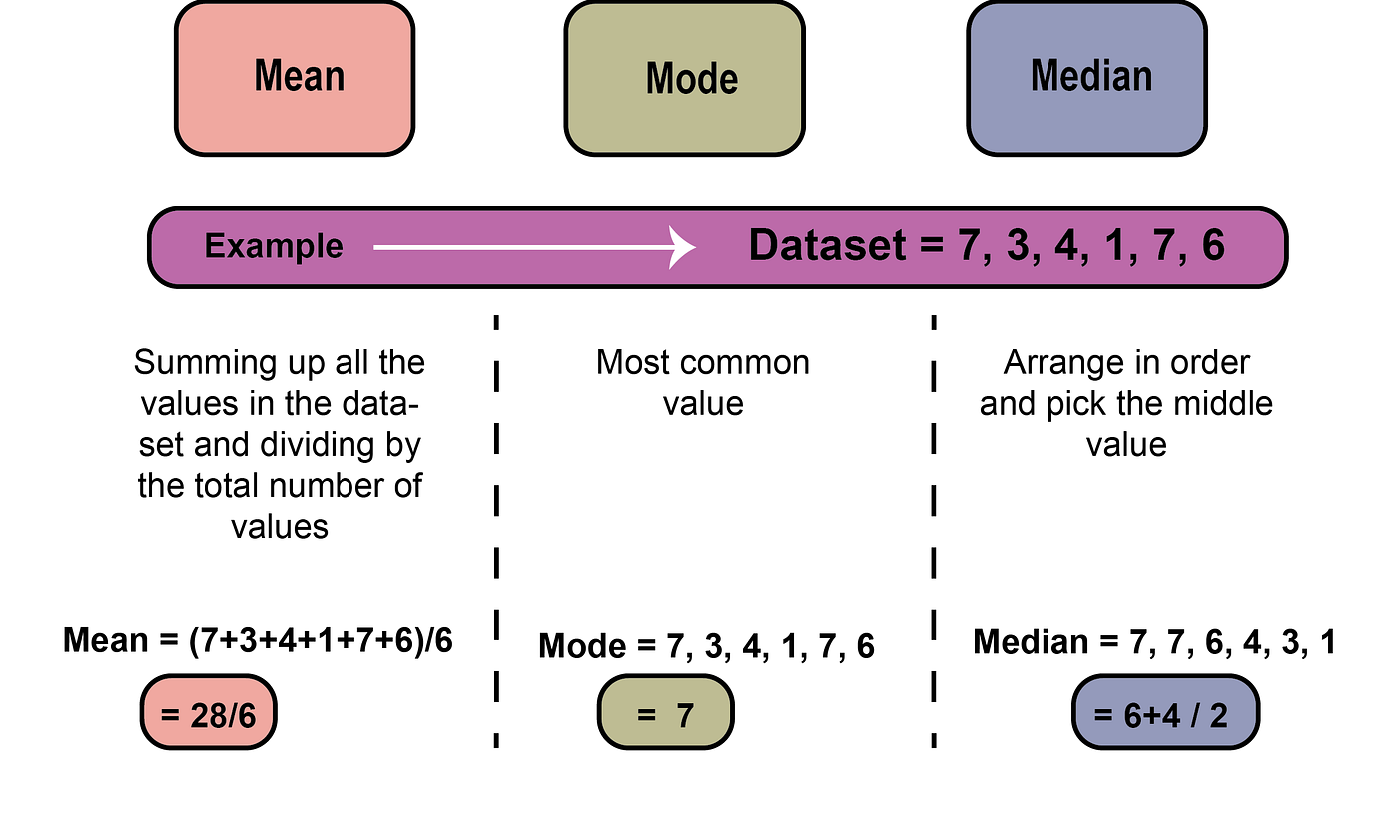
Measures of Central Tendency
These are single summary values that describe the central location of a dataset. The mean is the average value, the median is the middle number in an ordered dataset, and the mode is the most frequent value.

Slide 15
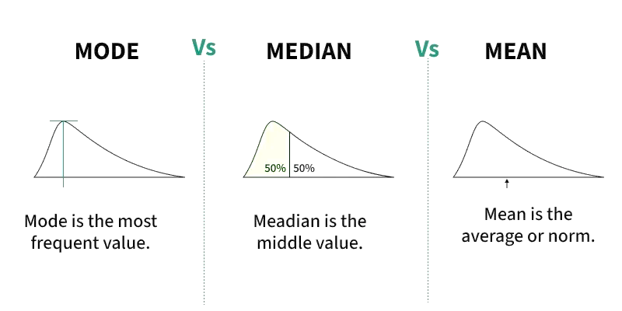
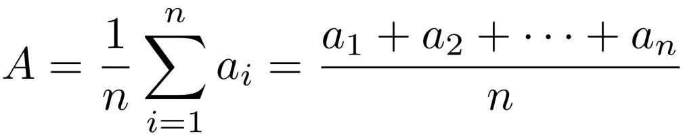
Mean or Average
The mathematical average of a set of two or more numbers is called its mean.
Mathematically,

Slide 16
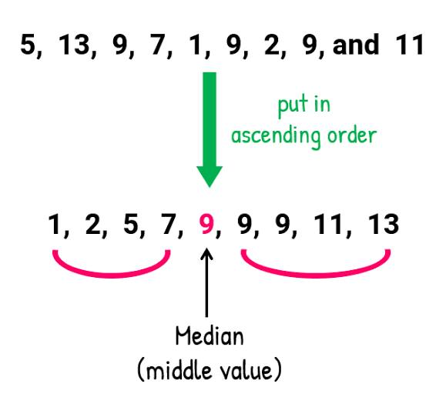
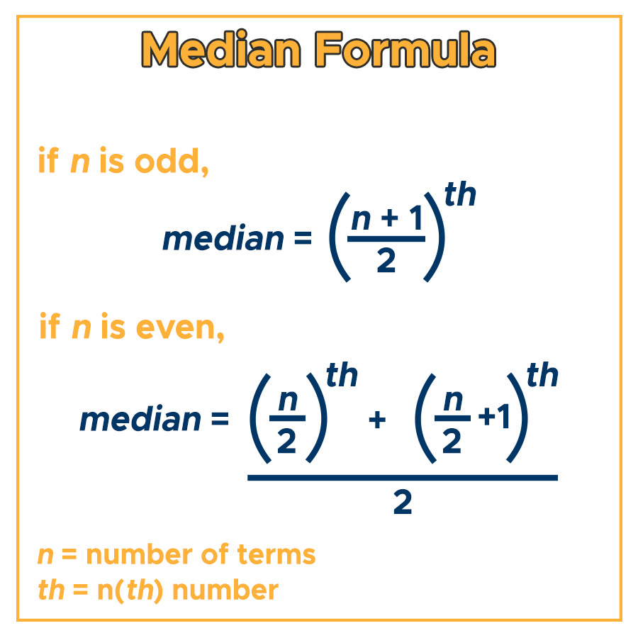
Median
The median is the middle value in a dataset that has been arranged in ascending or descending order.
When the number of elements is odd:
When the number of elements is even:

Slide 17
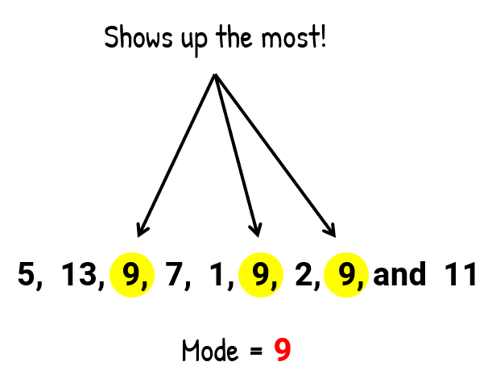
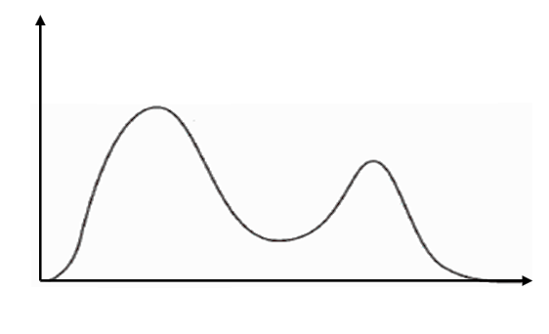
Mode
The mode is the most frequently occurring value in a dataset.
There can be more than one mode, or no mode at all.

Slide 18
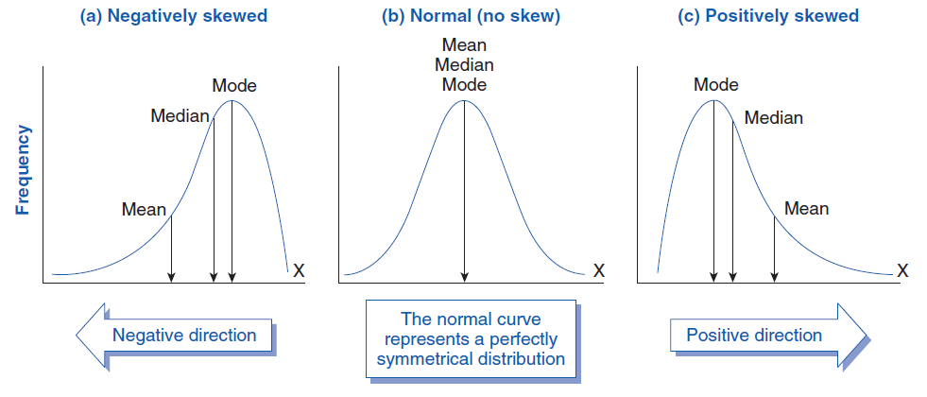
Relationship Between Mean, Median, and Model

Slide 19

Happy Coding

